Slide 1
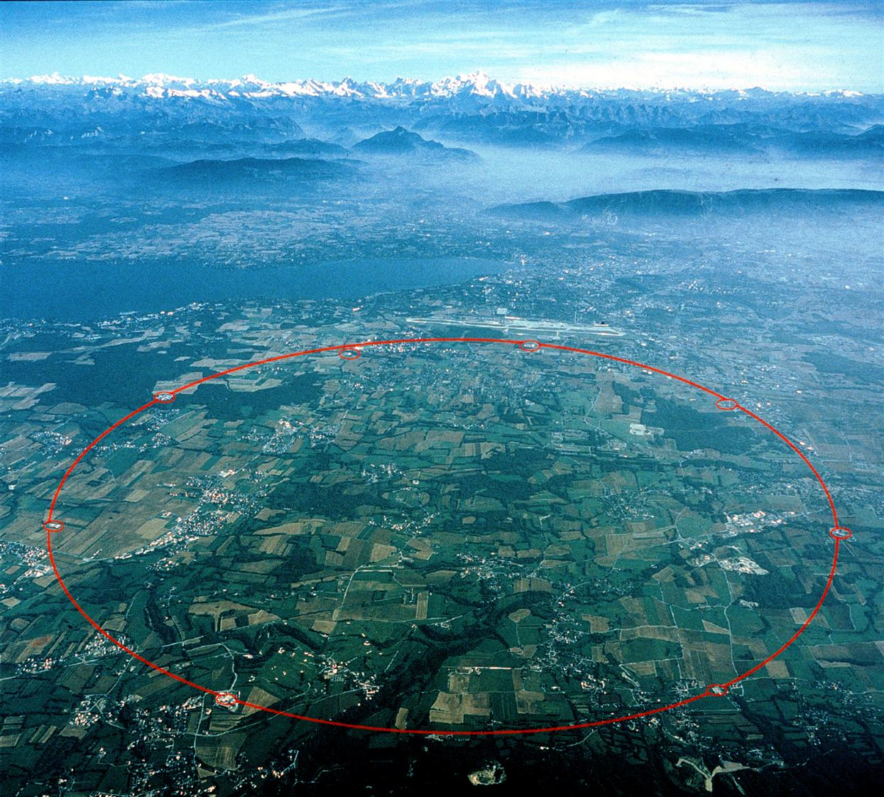
Methods of Experimental Particle Physics
Alexei Safonov
Lecture #14

Slide 2
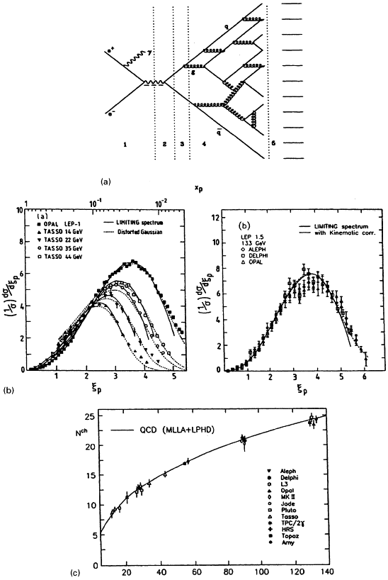
Jet Production
Two things to note:
  Each quark showers a lot as the QCD coupling is strong
    Means we would have to do calculations to some potentially very high orders
    Even though the two initial quarks give the direction and energy to two jets, they still “talk”
      As they need to cancel each other’s color the color string is getting stretched producing some particles flying far from the directions of the parent quarks

Slide 3
“Factorization”
Doing any calculable predictions would be impossible without simplifications:
  Break into two stages with very different energy scales:
    Produce two energetic quarks
      Hard process as energies are high
      Very perturbative regime, calculations should work fine
    Let each quark independently shower (called fragmentation) – difficult:
      This is much softer process, one would wonder if QCD would even work there
      At the end of it the groups of quarks/gluons form hadrons (very soft process, perturbative methods can’t work – need some modeling)
  Then apply correction to account for broken strings (add particles between main quarks that are there to cancel the color flow)

Slide 4
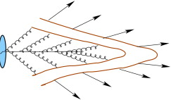
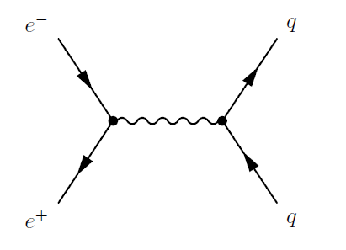
“Factorization”
The same schematically: hard scatter times fragmentation times hadronization:
=
X
=
+ corrections
X

Slide 5
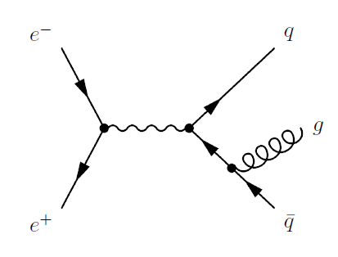
QCD Diagrams
Say what you are trying to calculate is how often one can get jets
  You are calculating “inclusive jet production” cross-section
At e+e- machine, this diagram is the Leading Order (LO):
But quarks can emit gluons, which can look like jets too, so you need to take into account corrections:
  You would call this the Next-to-Leading Order (NLO) contribution to your cross-section
QCD NLO corrections are often large, e.g. qq-bar->Z cross-section at NLO is about 1.4 that at the LO

Slide 6
Caveats
If you are calculating the cross-section of a three-jet production
  The same diagram will be considered as the LO
If you are calculating the cross-section of a two-jet production, things can get complicated:
  The same diagram may or may not count at all
    If the gluon is hard enough and forms a jet, this will be a 3-jet event and won’t count
    If the gluon is soft, you may not notice it experimentally or it can merge with one of the quark jets, so it may count towards a 2-jet event
      Definition of what is a jet is important

Slide 7
Hard Vs Soft
In principle, you could count an emitted gluon as part of the hard scatter
Or you could say it’s already part of this quark fragmentation
How do you decide?
  If you could do non-perturbative calculations, you could do either and the result wouldn’t matter
  Otherwise you do this: if the gluon is hard, include it into the hard scatter, if it’s soft - you can’t do perturbative calculatiuon
    You have no choice but pushing it into the fragmentation part and hope someone else knows how to calculate it
X

Slide 8
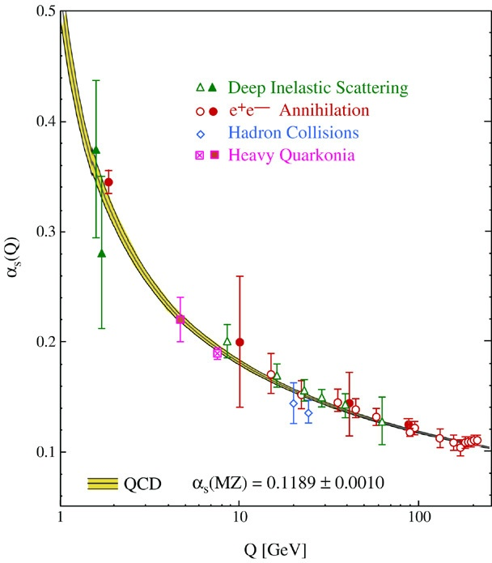
Soft Versus Hard
There is no formal border, but alpha_s depends on momentum transfer, so it’s of the order of the gluon transverse momentum
p_{T} less than 10-20 GeV is often considered a border region as alpha becomes large and your perturbative series may be too slowly converging
  And who is going to calculate NNNLO for you, which is likely still large?

Slide 9
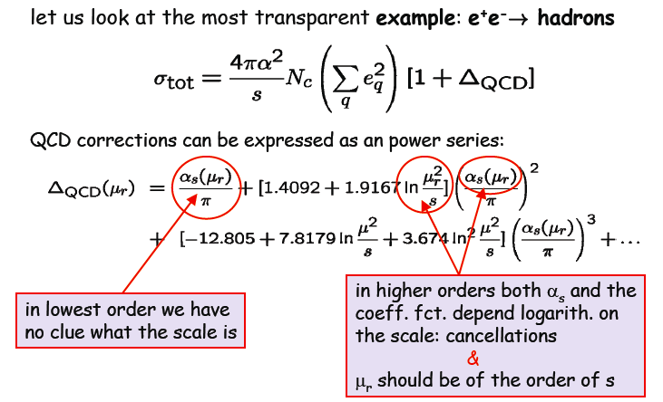
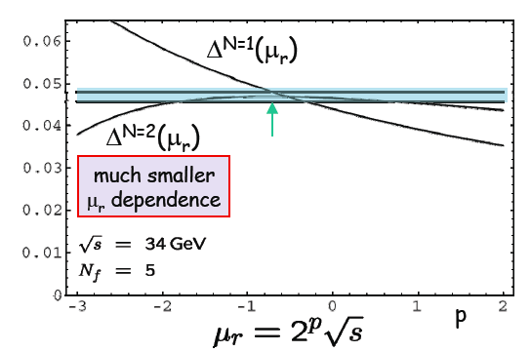
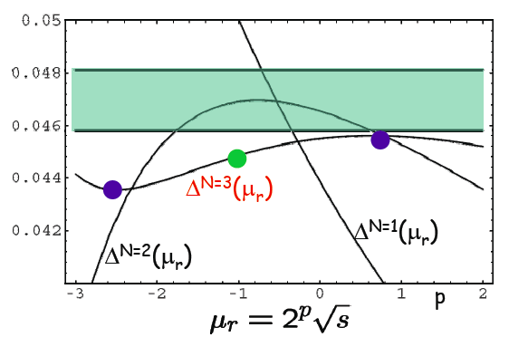
Scale Dependence
Rule of thumb – vary scale by a factor of 2

Slide 10
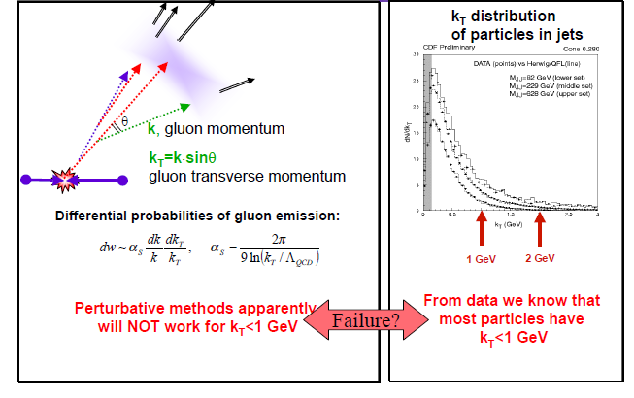
Fragmentation
Consider the probability of a gluon emission:
It’s not just alpha_s, probability contains large logarithms
  Even if a fixed order gives you a fixed power of alpha_s, who knows how big those logs are (and they are big!)

Slide 11
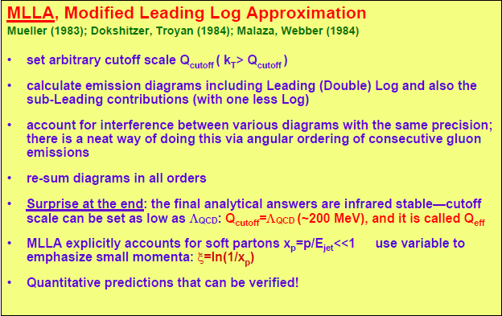
(N)LO versus (N)LL
Instead of summing up terms with fixed power of alpha_s, calculate all diagrams and sum up the terms with largest logs
  Leading Log means sum up terms with the highest power logarithmic terms
  NLL is the highest and the next to highest power log
Leading Log expansion is another way of re-summing things in QCD compared to normal order expansion

Slide 12
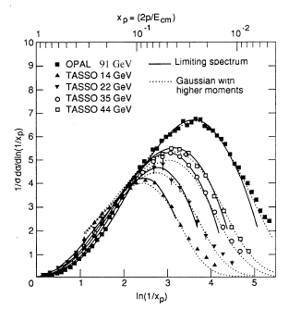
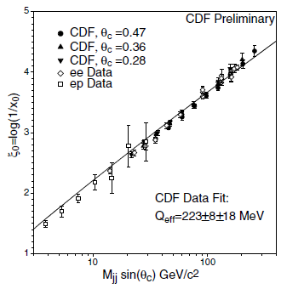
NLL and Fragmentation
Long story short – somehow this trick is working
Modern event generators use NLL based calculations to describe jet fragmentation
  Also need to supplement it with some model to convert quarks and gluons into hadrons
  Local Parton Hadron Duality – one parton gives you roughly one hadron during hadronization stage

Slide 13
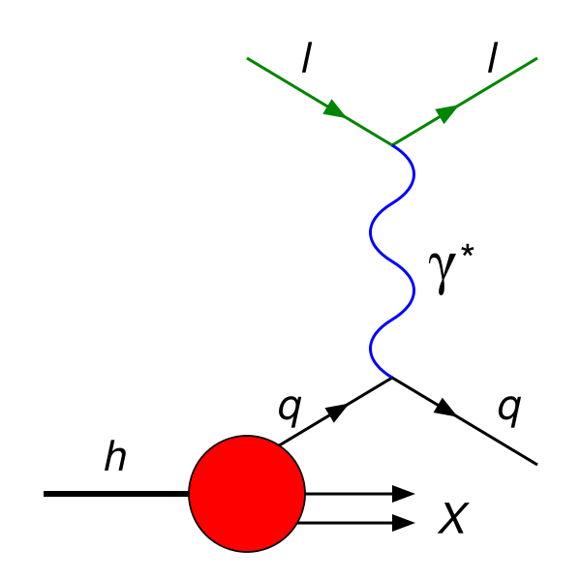


Probing Hadrons
For processes involving initial state hadrons, we need to do a little more
  As the interacting entities are not protons, but quarks, we need to take that into account somehow
A classical illustration is the deep inelastic scattering ep->e+X:
  The photon “probes” proton
  k – electron momentum, p-proton momentum, q – photon momentum, Q²=-q² (photon is virtual),

Slide 14
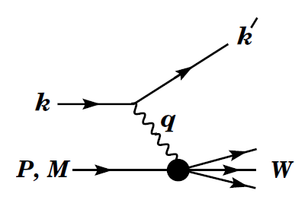
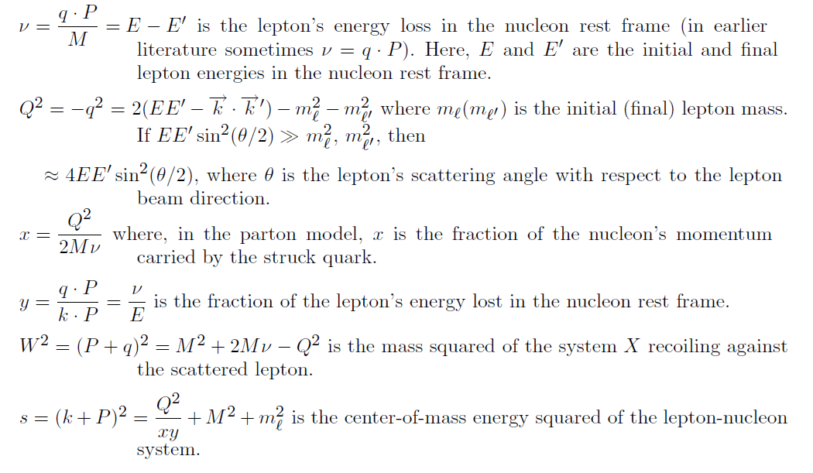
DIS

Slide 15

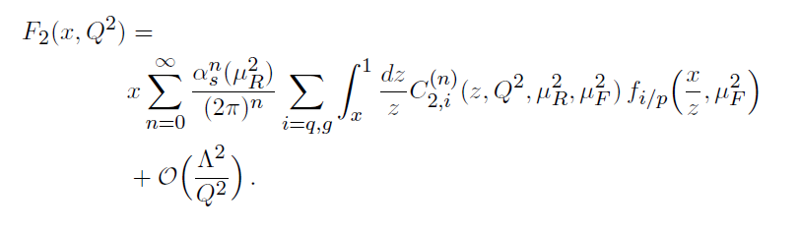
DIS Cross-Section
f_{q/p}(x) is the PDF for quarks of type q inside the proton, i.e. the number density of quarks of type q inside a fast-moving proton that carry a fraction x of its longitudinal momentum
  At higher orders:

Slide 16
Factorization Scale
The factorization scale, μ_{F}:
  Emissions with transverse momenta above μ_{F} are included in the C
  Emissions with transverse momenta below μ_{F} are accounted for within the PDFs, f_{i/p}.
It is as unphysical as the renormalization scale, so physical results should not depend on it

Slide 17
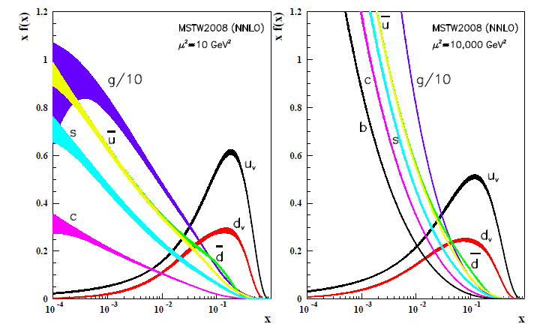
Proton Parton Distribution Functions

Slide 18
Next Time
Calorimeters, Triggers, Particle Flow

